Slide 1
Institute for Quantitative & Computational Biosciences Workshop4: NGS- study design and short read mapping

Slide 2
Day 3
Analyzing an alignment file
Alignment file formats – SAM and BAM
SAMtools
BEDtools
Picard tools

Slide 3
SAM format

Slide 4
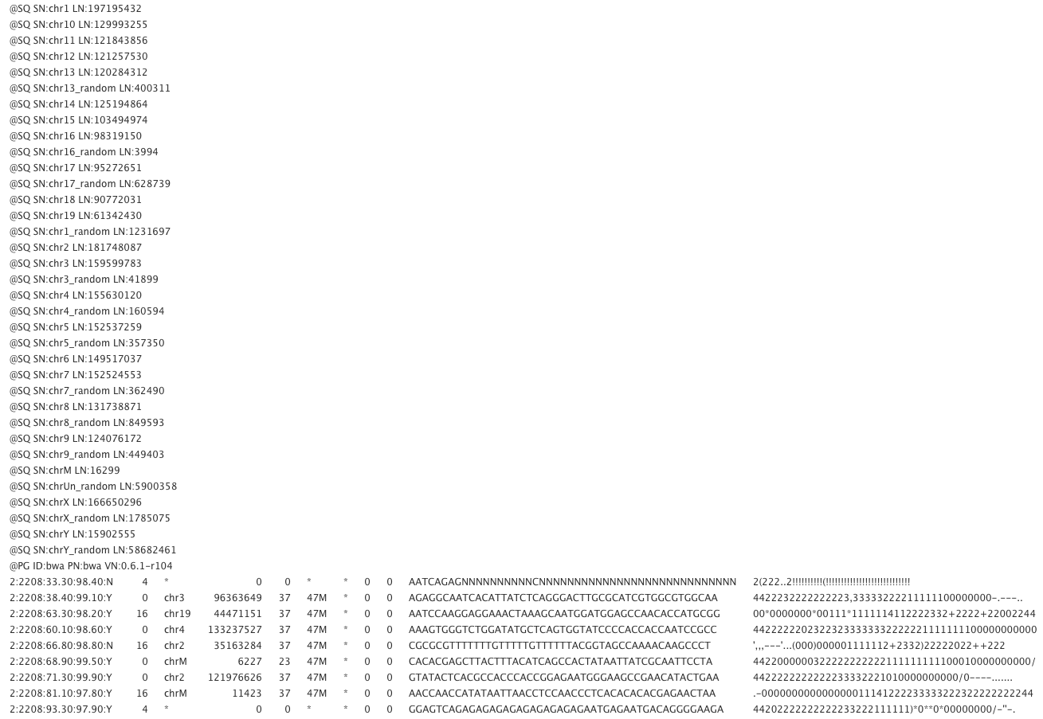
Alignment files – SAM format
SAM format specification
http://samtools.sourceforge.net/SAM1.pdf

Slide 5
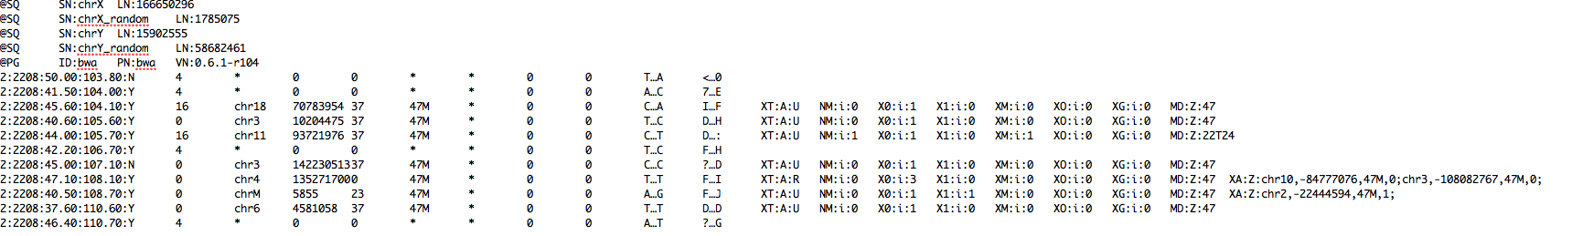
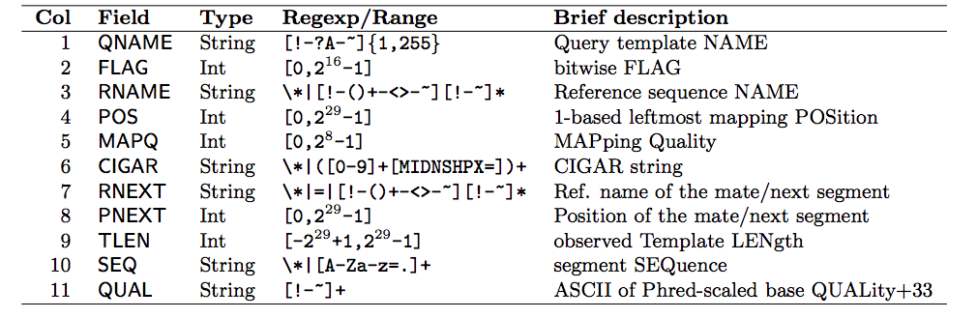
Alignment files – SAM format
Mandatory fields

Slide 6
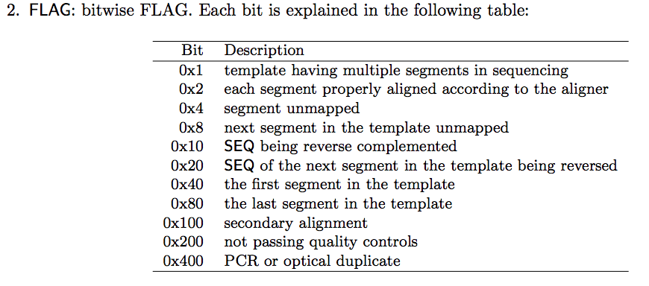
http://broadinstitute.github.io/picard/explain-flags.html

Slide 7
FLAG meaning in English | FLAG
read paired | 1
read mapped in proper pair | 2
read unmapped | 4
mate unmapped | 8
read reverse strand | 16
mate reverse strand | 32
first in pair | 64
second in pair | 128
not primary alignment | 256
read fails platform/vendor quality checks | 512
read is PCR or optical duplicate | 1024
Most common flags:
0 (mapped, not paired, forward strand), 4 and 16.
Notes:
This depends on what you want to do. If you are using paired-end reads, the 0x2 flag means that both ends of the read were mapped and they were mapped within a reasonable distance given the expected distance (and probably standard deviation) that you gave the alignment software
That is not always the whole story..."proper pair" can also mean that the reads are correctly oriented with respect to one another, i.e. that one of the mate pairs maps to the forward strand and the other maps to the reverse strand. If the mates don't map in a proper pair, that may mean that both reads map to the forward or reverse strand.

Slide 8
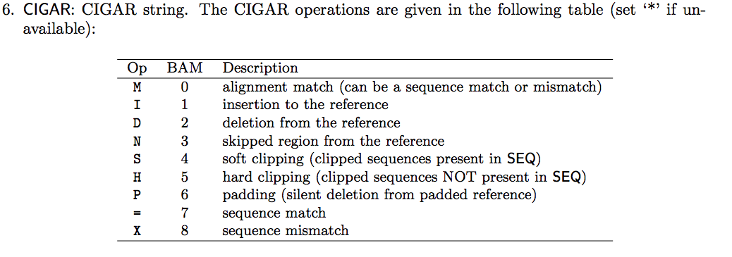
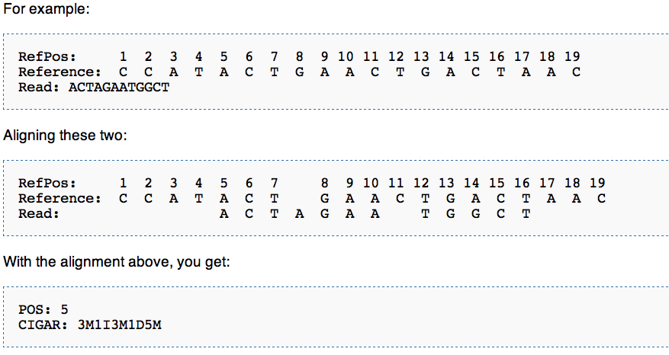
CIGAR string summarizes the alignment to reference
Notes:
The sequence being aligned to a reference may have additional bases that are not in the reference or may be missing bases that are in the reference.
The CIGAR string is a sequence of of base lengths and the associated operation.
They are used to indicate things like which bases align (either a match/mismatch) with the reference, are deleted from the reference, and are insertions that are not in the reference.
The POS indicates that the read aligns starting at position 5 on the reference. The CIGAR says that the first 3 bases in the read sequence align with the reference. The next base in the read does not exist in the reference. Then 3 bases align with the reference. The next reference base does not exist in the read sequence, then 5 more bases align with the reference. Note that at position 14, the base in the read is different than the reference, but it still counts as an M since it aligns to that position.

Slide 9
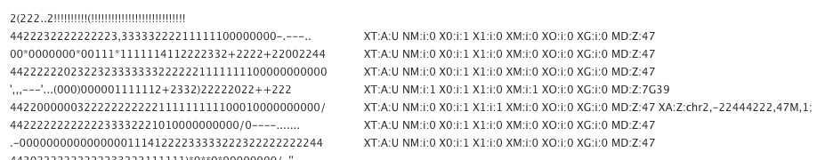
Last, but very important, SAM field is the TAG field
Each TAG has a meaning and summarizes some aspect of the alignment.
Some tags (e.g. NM) have a predefined meaning in the format, NM is the number of mismatches between the read and the template
Other tags (e.g XT) are program specific – XT:A:U/R in BWA tells whether there is one or many “best alignments” for the read.
There are numerous predefined, or program specific tags that convey much useful information about each alignment, and alternative mappings for the reads. These tags are used when you filter alignments based on number of mismatches, or unique versus repeat, etc.

Slide 10

Adjusting alignment is an iterative process
Read formatting (demultiplex, convert to fastq)
Select 1M reads (or pairs) for each sample
Read processing (QC, trim, filter…)
Adjusting parameters
Mapping to template
Repeat calibrated process for entire sample

Slide 11
Manipulating alignment files on Hoffman
http://samtools.sourceforge.net/samtools.shtml
http://picard.sourceforge.net/explain-flags.html
Useful link with common samtools commands:
http://davetang.org/wiki/tiki-index.php?page=SAMTools

Slide 12
Filter alignments in SAM file –
Uniquely aligned reads or reads with multiple alignments?
Alignment quality?
Number of mismatches?
Indels?......
SAM file with the alignments you think are relevant.
my_favorite_sample. SAM
my_favorite_sample_clean. SAM

Slide 13

SAM tools & Picard tools

Slide 14
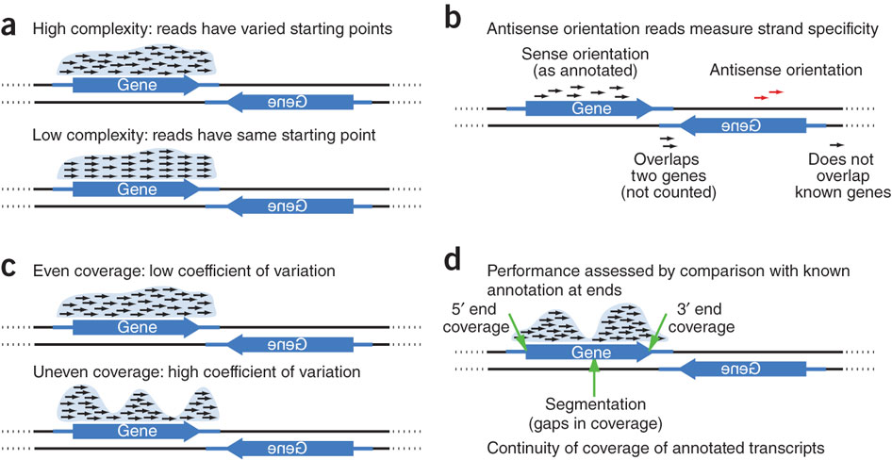
RNA-SeQC metrics
https://confluence.broadinstitute.org/display/CGATools/RNA-SeQC#RNA-SeQC-ExampleRNA-seqData
Levin 2010, Nature Methods

Slide 15
Alignment files – SAM format - QC
Potential artifacts
GC bias – often sample or library specific
very influenced by gel elution step.
Library complexity – how many different starting points for fragments relative to how many you could have.

Slide 16
Alignment files – SAM format - QC
Potential artifacts
Removing PCR duplicates – rmdup in SAM tools
Basically it looks for identical fragment that is much more abundant than expected.

Slide 17
Manipulating alignment files on Hoffman
* Usage of view:
samtools view [-options] input.bam > output.sam
view is the command for manipulating bam (or sam) files (filtering, converting format…)
* Real example:
samtools view -h -f 2 input.bam > input_PropP.sam
keep header (required to convert back to bam)
filter alignments with bitwise flag 2 present (properly paired)
* Usage of flagstat:
samtools flagstat input.bam
flagstat is the command for summary of alignment file in bam format.
* Example using flagstat:
samtools flagstat accepted_hits.bam

Slide 18
Let’s do some examples on the cluster

Slide 19
Mapping on Hoffman – QC using samtools “flagstat”
Note: Must use “.bam” file
1. Module load and go to directory
module load samtools
cd ~/scratch/Workshop4/samtools/
2. Convert a “.sam” file to “.bam” format using “view” tool
samtools view -bS ../data/sample.sam > sample.bam
3. Alignment stats using “flagstat” tool
samtools flagstat sample.bam > summary_flagstat
tool from samtools
input file
output file
-bS = use if header information is available

Slide 20
Mapping on Hoffman – QC using Picard
Picard tools: AlignmentSummaryMetrics
Can use sam or bam file
1. Go to directory
cd ~/scratch/Workshop4/picardtools/
java -jar /u/local/apps/picard-tools/current/CollectAlignmentSummaryMetrics.jar INPUT=../data/sample.bam OUTPUT=summary_metrics REFERENCE_SEQUENCE=../data/genome.fa
Picard comprises Java-based command-line utilities that manipulate SAM files, and a Java API (HTSJDK) for creating new programs that read and write SAM files. Both SAM text format and SAM binary (BAM) format are supported.
http://picard.sourceforge.net/index.shtml

Slide 21
Filter alignments in SAM file –
Uniquely aligned reads or reads with multiple alignments?
Properly aligned reads?
Mapping quality?
Remove duplicates
Application dependent
PE orientation (depends on application)
Phred score >20 (99%) or 30 (99.9%)
“rmdup” to remove PCR duplicates
Notes:
What does properly aligned mean?

Slide 22
SAM tools
MANUAL: http://www.htslib.org/doc/samtools-1.1.html
Utility | Description
view | Convert between sam/bam format, and filter alignment file
sort | Sort alignments by genomic position
index | Creates a new index file that allows fast look up, generating *.sam.sai or *.bam.bai files. These files are required by some genome browsers
mpileup | Creates pileup format, i.e. BCF files, which gives overlapping read bases or indels for each genomic position. Can be used for variant calling
flagstat | Summary alignment statistics
merge | Merge multiple bam files into one bam aligment file. For example, if you have one bam file for each tile, combine all into one bam file for the sample
rmdup | remove potential PCR duplicates
bam2fq | convert bam to FASTQ format

Slide 23
Picard tools
https://broadinstitute.github.io/picard/command-line-overview.html
Utility | Description
CollectAlignmentSummaryMetrics | Summary of alignment results from BAM or SAM
CollectBaseDistributionByCycle | Chart the nucleotide distribution per cycle in a SAM or BAM file
CollectGcBiasMetrics | Tool to collect information about GC bias
CollectInsertSizeMetrics | Metrics about the statistical distribution of insert size (excluding duplicates) Histogram plot
CollectRnaSeqMetrics | Metrics about the alignment of RNA to functional classes of loci in the genome:coding, intronic, UTR, intergenic, ribosomal
FilterVcf | Applies one or more hard filters to a VCF file to filter out genotypes and variants
MeanQualityByCycle | Generates a data table and pdf chart of mean base quality by cycle
MergeSamFiles | Merge multiple SAM files into one
ExtractSequences | Extracts intervals in an interval_list file from a given reference sequence and writes them in FASTA

Slide 24
BED tools

Slide 25
BED tools
Documentation: http://bedtools.readthedocs.org/en/latest/
BEDtools utilities are a swiss-army knife of tools for a wide-range of genomics analysis tasks
There are 36 scripts – each does something simple in a fast and efficient way
For example: intersect, merge, count, complement, and shuffle genomic intervals from multiple files
Work with many widely-used genomic file formats including: BAM, BED, GFF/GTF, VCF.
While each individual tool is designed to do a relatively simple task (e.g., intersect two interval files), quite sophisticated analyses can be conducted by combining multiple BEDtools operations on the UNIX command line.

Slide 26
BED format
BED is an interval format:
The first three required BED fields are:
1. chrom – e.g. chr19
2. chromStart - The starting position of the feature in the chromosome or scaffold. The first base in a chromosome is numbered 0.
3. chromEnd - The ending position of the feature in the chromosome or scaffold. The chromEnd base is not included in the display of the feature. For example, the first 100 bases of a chromosome are defined as chromStart=0, chromEnd=100, and span the bases numbered 0-99.
http://genome.ucsc.edu/FAQ/FAQformat.html#format1

Slide 27
BED format
Additional optional fields are:
4. name - Defines the name of the BED line.
5. score - A score between 0 and 1000. For annotation purposes, ex: 7.31E-05 (p-value), 0.33456
6. strand - Defines the strand - either '+' or '-’.
7. thickStart
8. thickEnd
9. itemRgb
10. blockCount
11. blockSizes
12. blockStarts
Have to do with display in UCSC genome browser

Slide 28
BEDtools example
http://bedtools.readthedocs.org/en/latest/index.html
coverageBed computes both the depth and breadth of coverage of features in file A across the features in file B. For example, coverageBed can compute the coverage of sequence alignments (file A) across 1 kilobase (arbitrary) windows (file B) tiling a genome of interest. It counts the number of features that overlap an interval in file B, computes the fraction of bases in B interval that were overlapped by one or more features.
Notes:
Show example

Slide 29
BEDtools example
Usage:
coverageBed -abam sample.bam -b myfavoritefeatures.bed > result.out
Example:
1. Module load and go to directory
module load bedtools
cd ~/scratch/Workshop4/BED_example/
2. Compute coverage
coverageBed -abam ../data/sample.bam -b RefSeq_4c.bed > Coverage_result.out
tool from bedtools
input bam alignment file
input file with features of interest
output file
Notes:
Show example

Slide 30
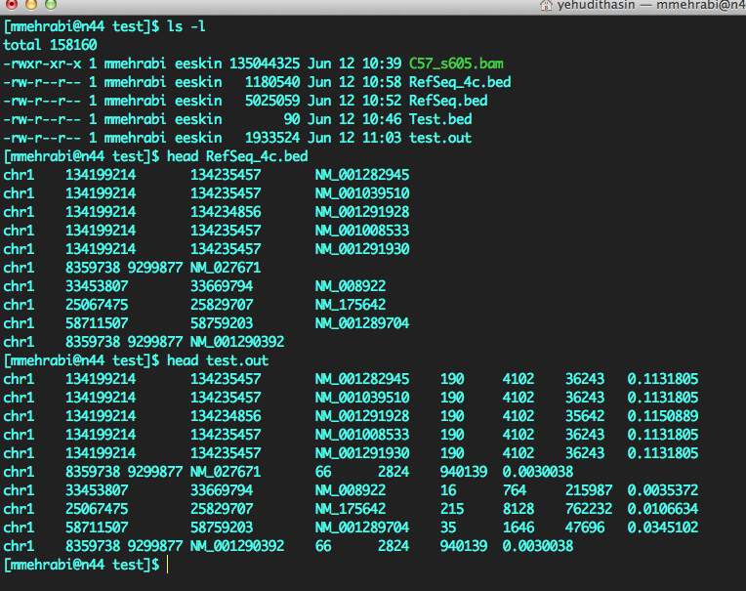
Alignment BAM file
Annotation.bed file
!! make sure chromosome names are the same as in bam header
Result file. Added columns:
The number of features in A (bam) that overlapped (by at least one base pair) the B interval (favorite intervals in bed).
The number of bases in B that had non-zero coverage from features in A.
Feature length (Stop-start) in B
The fraction of bases in B that had non-zero coverage from features in A.(=added column2/added column3)

Slide 31
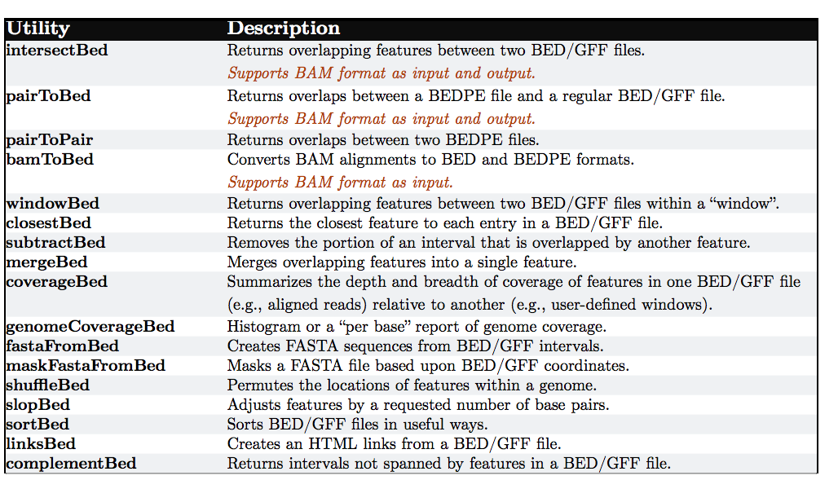
BED tools
http://bedtools.googlecode.com/files/BEDTools-User-Manual.pdf

Slide 32
General basis of all types of NGS analysis
1. Read processing (de-multiplex, trim, filter…)
sample 1
sample 2
sample 3
2. Mapping to template
Template feature
Template feature
Template feature
Discovery
DNA variants,
splicing variants….
3. Count
region/sample | s1 | s2 | s3
region1 | 6 | 10 | 20
region2 | 150 | 100 | 255
……
Quantitative comparison
Expression
Binding

Slide 33
General basis of all types of NGS analysis
my_sample_clean. SAM
Discovery
DNA variants,
splicing variants
Quantitative comparison
Expression W3 and W5
RNA-seq
Binding W7 chIP-seq
Methylation W6 BS-seq
Tools
GATK (NGS:GATK tools)
Mpileup (NGS: SAM tools)
region/sample | s1 | s2 | s3
region1 | 6 | 10 | 20
region2 | 150 | 100 | 255
……
W8 using GATK
Notes:
Mpileup is part of SAM tools for calling SNPs and short INDELS

Slide 34
Quantification and Differential expression with counts
There are a number of statistical packages for comparing counts that originate from sequencing data:
 | s1 | s2 | s3 | s4 | s5 | s6 | p val | q val
Gene1 | 6 | 10 | 20 | 15 | 18 | 360 | 1e-6 | 0.03
Gene2 | 150 | 100 | 255 | 400 | 150 | 541 | 0.007 | 1
Gene3 | 6 | 10 | 20 | 45 | 80 | 350 | 1e-20 | 1e-10
Gene4 | 150 | 100 | 255 | 30 | 150 | 100 | 0.154 | 1
DEseq
EdgeR
baySeq
NOISeq
Cufflinks
p value cutoff
 | s1 | s2 | s3 | s4 | s5 | s6 | p val | q val
Gene1 | 6 | 10 | 20 | 15 | 18 | 360 | 1e-6 | 0.03
Gene3 | 6 | 10 | 20 | 45 | 80 | 350 | 1e-20 | 1e-10
Workshop 3 and 5
Workshop 5

Slide 35
Homework

Slide 36
Try other samtools, bedtools, and picardtools on your own

Slide 37
THANK YOU

